Slide 1
Verb 2
(page 01)

Slide 2

to get something by paying money for it

Slide 3
to buy: /baɪ/ to get something by paying money for it
Ex: The money will be used to buy equipment for the school.

Slide 4
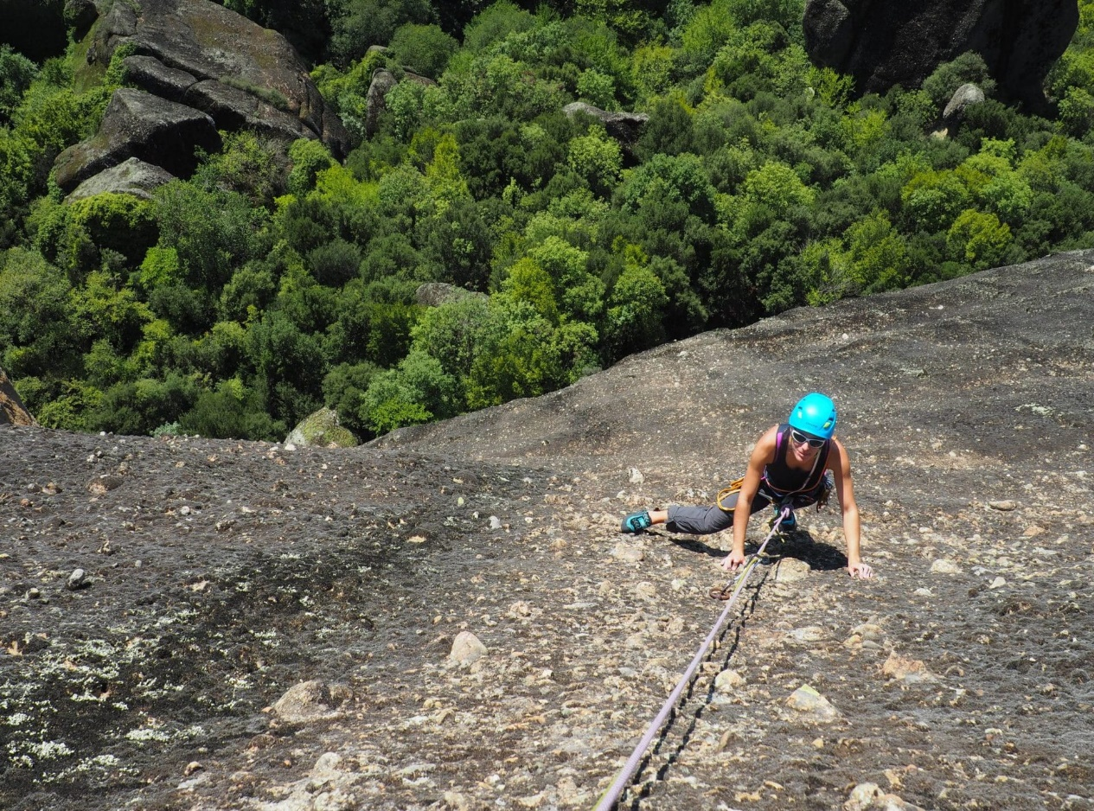
-to move up, down, or across something using your feet and hands, especially when this is difficult to do
- to move gradually to a higher position

Slide 5
to climb: / klaɪm /
- to move up, down, or across something using your feet and hands, especially when this is difficult to do
- to move gradually to a higher position
Ex: The wall is too high to climb over.

Slide 6
to get something by paying money for it

Slide 7
to buy: /baɪ/ to get something by paying money for it
Ex: The money will be used to buy equipment for the school.

Slide 8
to get something by paying money for it

Slide 9
to buy: /baɪ/ to get something by paying money for it
Ex: The money will be used to buy equipment for the school.

Slide 10
Thanks you

